Slide 1
Sanjivani College Of Engineering, Kopargaon
Computer Department
Corn Disease Detection Using Deep learning
ADVIT AI Group ID : 3
Group Member:
1) Chinmay Sadaphal
2)Ashitosh Rohom
3)Tejas Salve
4)Aditya Medhkar
Guided by : Dr. A. V. Brahmane

Slide 2
Introduction :
Agriculture been the most important work or task which has no end, the work with such an endless entity needs automation and smartness.As population increasing day by day the number to people to be stomach filled are increasing. To fulfill this increasing demand for food increase in yield is major concern. This needs hybridization, each innovation has major profits and some losses. In this case the crops have been acquainted to various diseases to tackle such an huge proportion diseases their need to have an prior knowledge about them and also quick identification for this disease. The document mainly focuse on the priority solutions for disease detection in crops(majorly corn) using machine learning and deep learning techniques.
To maintain such an interesting disease record using image comparison to train the data the large dataset with huge sample images to train the model is must. The paper focuses on methodology and future trends in this disease detection with the learning technologies and maintaing accuracy at the results.

Slide 3
Project Deliverables:
• Appropriate output record.
• Proper documentation
• Project to be accomplish in specific time window
• Bi-weekly meetings with the Automaton AI team
• Journal / paper publishing along with project guidance from Automaton AI & concerned

Slide 4
Requirements :
Normal :
1. The system should be available 24/7 for access and disease detection
2. The major disease that affect maize must be included in the system
3. The accuracy of the system should be more in order to get precise results
Expected :
The large amount of data must be trained to get accuracy in disease detection
Preprocessing must be standardized
Creating a good graphical interface for the system

Slide 5
Excited :
The system can be used in smart agriculture projects on large scale
2. With help of iot the system can work to play major role in spraying required pesticides
3. Alternative crops can be added to the system to create a complete platform at one place
Dataset :
Kaggle: https://www.kaggle.com/datasets/smaranjitghose/corn-or-maize-leaf-disease-dataset/code

Slide 6
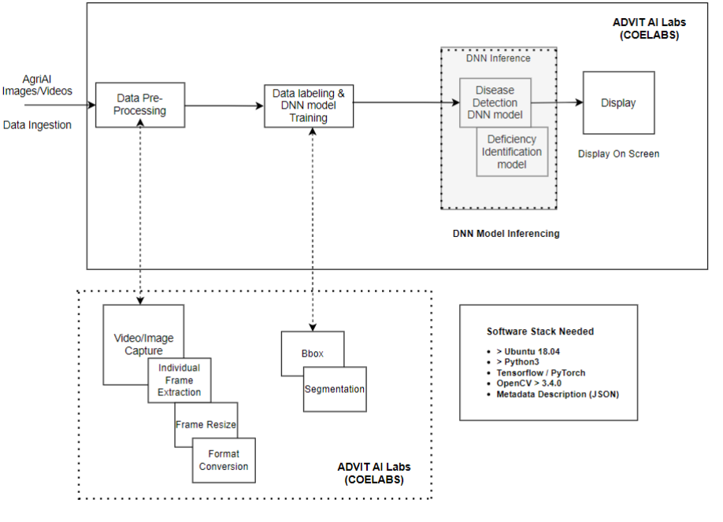
Approach :

Slide 7
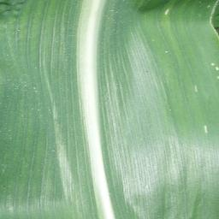
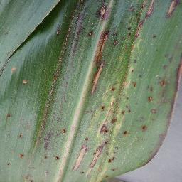
Healthy leaf :
grey Leaf spot :

Slide 8
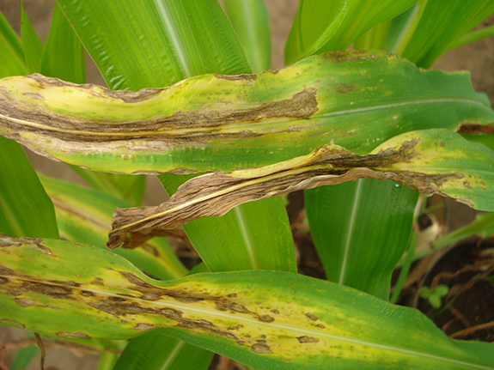
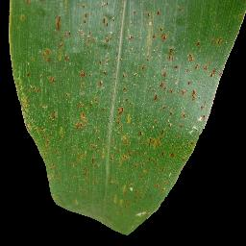
Blight :
Common rust :

Slide 9
Thank you…!

